Slide 1

Team 7 Iteration 1
Members: Paul Patraca Pantoja
Utsav Dhungana
Bipul Karki

Slide 2
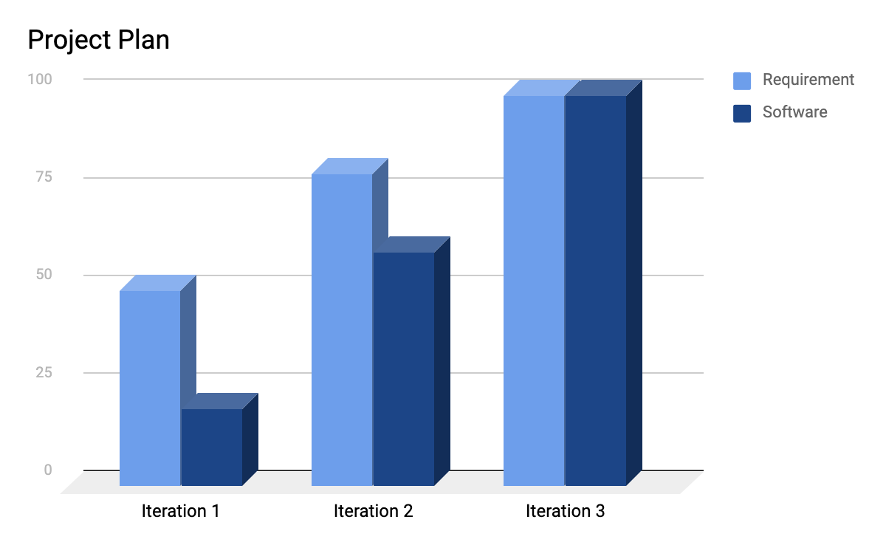
How is Carronade Doing?
Week one
M | T | W | TH | F | SA | SU
Meet up and work on iteration documentation
Requirement Analysis and UML sketching
Start coding and Testing
Week Two
M | T | W | TH | F | SA | SU
Plan for next iteration; virtual meeting
Demo and requirement lookover
Finish up the final touches

Slide 3
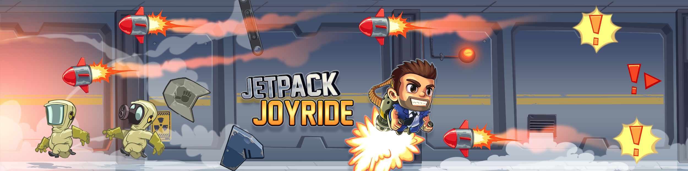
Closely Related apps:
https://www.malavida.com/en/soft/jetpack-joyride/iphone/#gref
No health-bar or any power ups
Tokens can be redeemed for gaining life

Slide 4
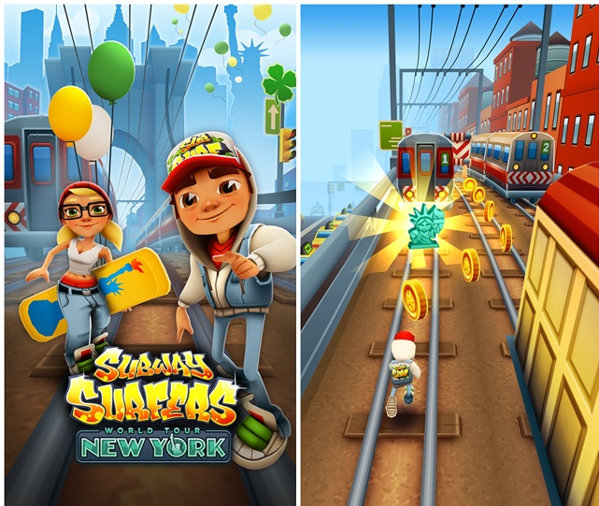
3. Not much to handle by AI
4. Non-Minimalistic
https://mspoweruser.com/subway-surfers-updated-with-new-york-city-world-tour-in-windows-phone-store/

Slide 5
Top 5 Risks
No. | Risks | RE | Mitigate (How / When ?)
1 | Poor programming practices lead to memory leaks and slow down the user’s machine. | RE = 0.4 * 10 = 4hrs | Careful and thoughtful use of documentation and available resources during each iteration.
2 | Exceeding the deadline to complete the project i.e project not completed on time. | RE = 0.2*20 = 4 hrs | Making a good planning on project timeline for each iteration would solve the problem.
3 | Dropping the course by a team member. | RE=0.1*20 = 2 hrs | Confirmation among the members at least before second iteration.
4 | Poor communication between the team members. | RE=0.2*15 = 3 hrs | Strong communication throughout the class project using mediums like GroupMe.

Slide 6
Requirements (Updated/Deleted/Added)
Req. ID | Requirements | Functional/Non-Functional | Implementation Planning | Updated/Added/Deleted
R1 | The enemy shall throw objects towards the player when game starts | Functional | Iteration 1 | Added
R3 | The Player shall be able to mute the sound of the game. | Functional | Iteration 3
R6 | The Player shall be able to choose from different characters. | Functional | Iteration 2
R13 | The system shall inform if a high score is reached. | Functional | Iteration 3 | Added
R10 | The Player shall be able to change the graphical settings of the game. | Functional | Iteration 3

Slide 7
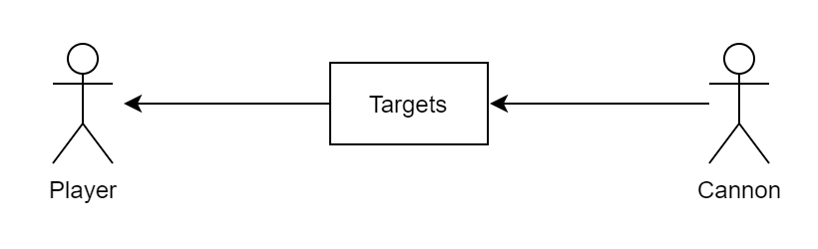
Use-Case

Slide 8
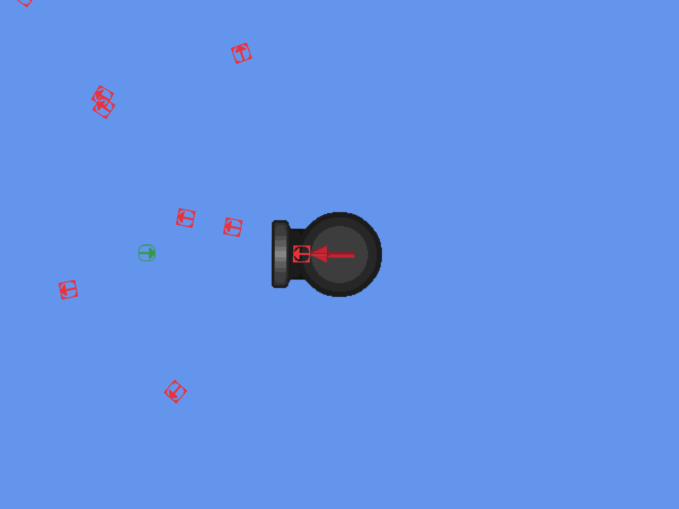
Sample prototype of the game
Play Screen 1.

Slide 9
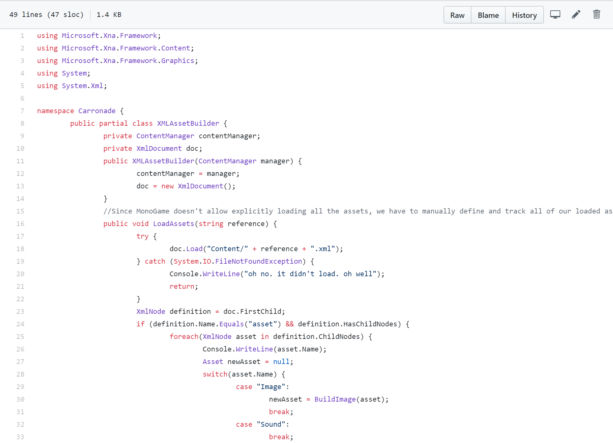
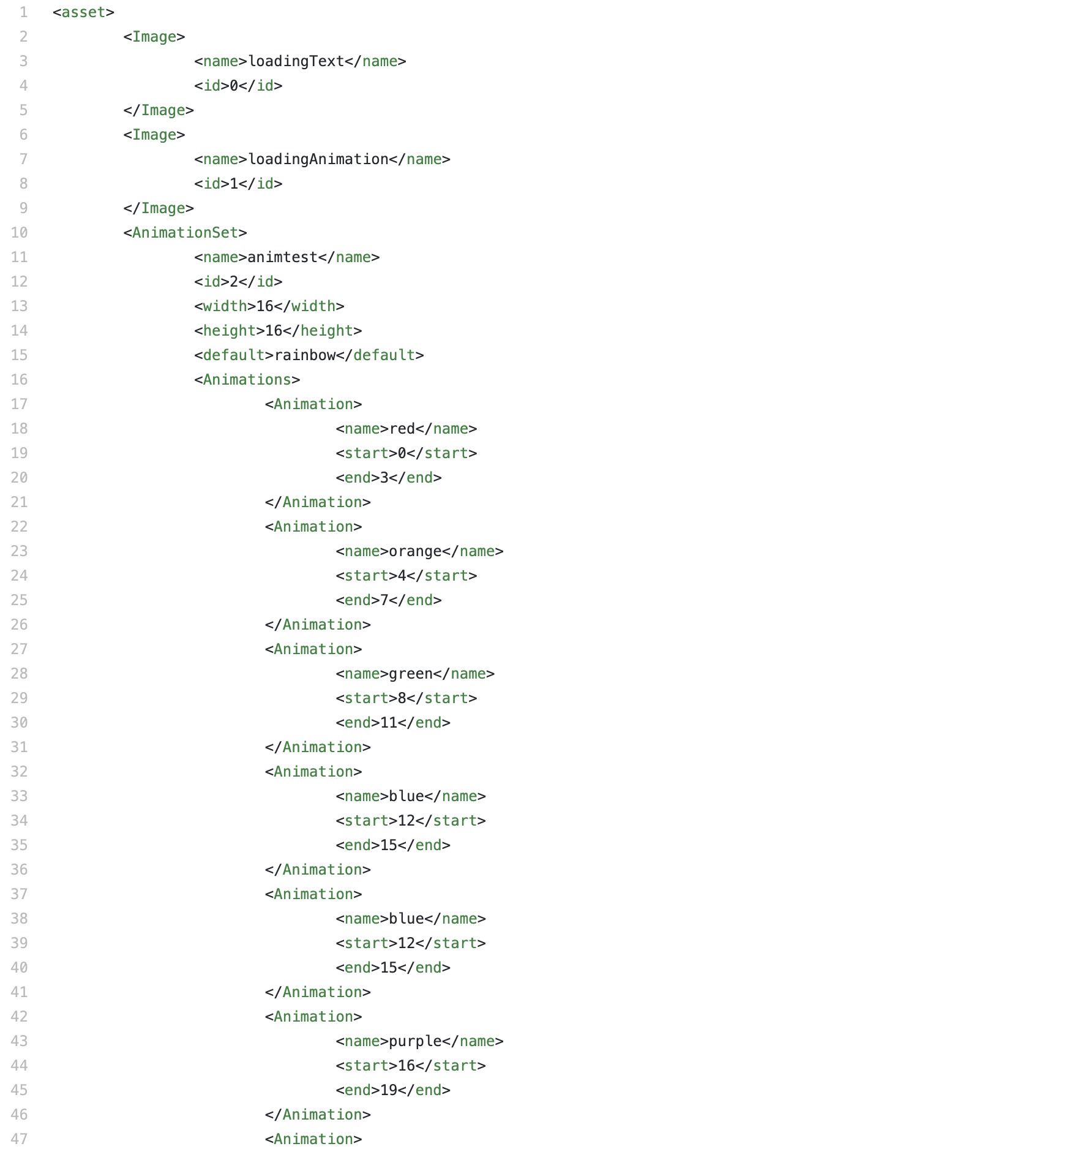
Code and Tests
https://github.com/udhungana/team7cse3311

Slide 10
Users and Customers
GitHub Link :
https://github.com/udhungana/team7cse3311
Carronade Version 0.1
Generally, all the users who play this game are our customers.
Feedback from colleagues.
Friends who game at UTA.

Slide 11
References
https://commons.wikimedia.org/wiki/File:Carronade_12_pounder.jpg
https://github.com/udhungana/team7cse3311
https://mspoweruser.com/subway-surfers-updated-with-new-york-city-world-tour-in-windows-phone-store/
https://www.malavida.com/en/soft/jetpack-joyride/iphone/#gref

Slide 12
Questions?

